Slide 1
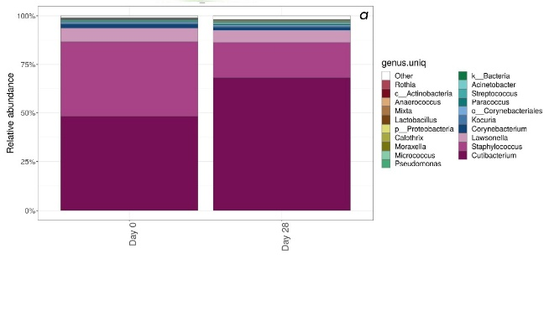
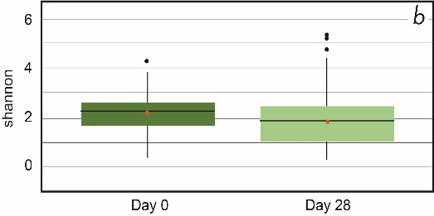
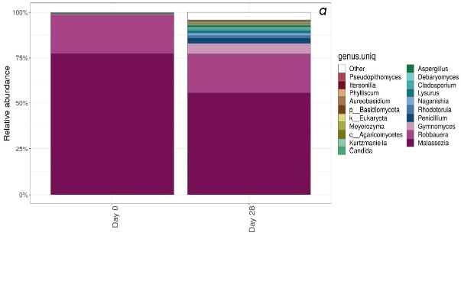
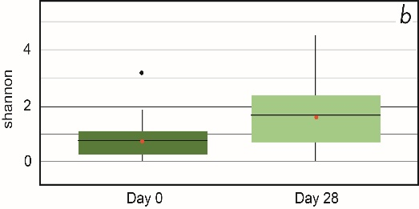
A selenium disulfide-based shampoo rebalances the scalp microbiome of subjects of any hair type
Pascal Edouard Reygagne¹, Claire Deloche-Bensmaine², Julie Faure², Natalia Kovylkina², Cecile Clavaud³, Audrey Gueniche³, Victoria Barbosa⁴
Centre Sabouraud, Hôpital St Louis, Paris¹, France, Vichy Laboratoires, Levallois-Perret, France², l’Oréal, R&I, Chevilly La Rue, France³, Section of Dermatology, University of Chicago, USA⁴
INTRODUCTION
MATERIAL AND METHODS
Dandruff is a mild form of seborrheic dermatitis (SD) of the scalp. Its prevalence has been estimated at up to 50% in the general population.³ It is observed in all phototypes and hair types. Dandruff in different ethnicities has been reported to present at higher prevalence in women of African American descent (81%–95%) than in other ethnic groups, such as Caucasian and Asian descent, with 66%–82% and 30%–42% prevalence, respectively.
Selenium disulfide (SeS₂) 1% shampoo is effective in dandruff, reducing scales and itching, while rebalancing the scalp microbiome. It improves clinical symptoms of scalp SD after treatment with ketoconazole. However, its efficacy in subjects of different hair types remains to be established.
A 6-week study was conducted in 93 adult subjects with all hair types represented (I-III: 41%, IV-V: 29%, VI-VIII: 30%) according to the de la Mettrie scale, to measure the clinical benefit of SeS₂ shampoo 1% in moderate-to-severe dandruff and its effect on the scalp microbiome. SeS₂ 1% shampoo was applied twice every week.
Dandruff and erythema were clinically scored. Maximum itching assessment was recorded.
Microbiome sampling was performed by swabbing a 2x2 cm² area at a lesional site of the scalp at Day 0 before the first treatment and Day 28 after 4 weeks of treatment.
For microbiome analysis, bacterial and fungal profiles were obtained using 16S and ITS amplicon sequencing, and Cutibacterium sp., Staphylococcus sp. and Malassezia sp. were quantified using qPCR .
OBJECTIVES
To assess the efficacy of a shampoo containing Selenium disulfide (SeS₂) 1% in reducing dandruff and erythema scores, and rebalancing scalp microbiome in subjects with diverse hair types.
Figure 1: Bacterial diversity at Day 0 and Day 28
RESULTS
Overall, of the 93 subjects, 69% were of European and 31% were of African origin. Dandruff scores, erythema and maximum itching decreased significantly for all hair types.
At baseline, the bacterial microbiome presented a typical scalp taxonomic profile dominated by Cutibacterium sp. and Staphylococcus sp., with a high proportion of Staphylococcus sp. (> 30%) as compared to reported data on healthy scalp.
Clinical and subject-assessed parameters had all significantly improved, regardless the hair type.
SeS₂ shampoo significantly decreased the bacterial diversity and improved the bacterial profile with a decrease in Staphylococcus sp. as confirmed by qPCR quantification (p<1.0 10^-5), with no impact on Cutibacterium sp.
The global bacterial community structure showed minor modifications (R=0.026, p=0.001 and R=0.033, p=0.004 for the weighted and unweighted Unifrac distances respectively).
SeS₂ shampoo induced a decrease in the Malassezia sp. relative abundance confirmed by qPCR quantification (p<1.0 10^-5). The fungal diversity had significantly increased, as measured by the alpha diversity (p<1.0 10^-5), with a highly-modified fungal community (R=0.34, p=0.001 and R=0.23, p=0.001 for weighted and un-weighted Unifrac distance, respectively.
Results were similar for all hair type subgroups.
Relative abondance of the top 20 most abundant bacterial genera 16S rDNA analysis); mean per group
Alpha-diversity
(Shannon index, p=1.04 10^-5
between Day 0 and Day 28)
Figure 2: Fungal diversity at Day 0 and Day 28
_{CONCLUSION}
SeS₂ 1% shampoo rebalances the scalp microbiome in all hair types supporting
its clinical benefit in seborrheic dermatitis with no between hair-type differences.
Relative abundance of the top 20 most abundant fungal genera (ITS rDNA analysis); mean per group
Alpha-diversity
(Shannon index, p=1.04 10^-5
between Day 0 and Day 28)
Conflict of interest: Pascal Reygagne and Victoria Barbosa served as consultants to l’Oréal Group. The other authors are employees of l’Oréal Group. Funding: Vichy Laboratoires, France. Acknowledgments: The authors acknowledge the participation of the subjects as well as the writing support and artwork of Karl Patrick Göritz, SMWS

